Slide 1


CareerCrafter: The Job Portal A Comprehensive Solution for Job Seekers and Employers
Photo by Google

Slide 2
01
Introduction to CareerCrafter
Table of Contents
02
Scope: User Registration and Authentication
03
Scope: Employer Module
04
Scope: Job Seeker Module
05
Scope: Application Management
06
Scope: Resume Database
07
Scope: Search and Recommendation Engine
08
Technologies Used: Frontend
09
Technologies Used: Backend
10
Technologies Used: Database
11
Technologies Used: Authentication
12
Use Case Diagram

Slide 3

1
Introduction to CareerCrafter
Addressing the Challenges in Job Searching and Recruitment
CareerCrafter aims to provide a robust platform for employers to post job listings and for job seekers to search and apply. The application includes features for user registration, employer module, job seeker module, application management, and a resume database. CareerCrafter is designed as a web-based application to ensure accessibility and ease of use for all users. Job seekers can store and share their qualifications seamlessly through the resume database feature.
Photo by Google

Slide 4

2
Scope: User Registration and Authentication
Secure Access and Role-Based Control
Users can register and create accounts with a secure authentication process. Implementing robust security measures to protect user data and prevent unauthorized access. Different access levels for employers and job seekers to ensure appropriate functionalities. Streamlined process for creating and managing user accounts.
Photo by Google

Slide 5

3
Scope: Employer Module
Managing Job Listings and Candidate Profiles
Employers can create, edit, and manage job listings with detailed information. A dashboard for employers to track applications and view candidate profiles. Tools for managing job postings, including updating and removing listings. Employers can view detailed candidate profiles to assess qualifications and experience.
Photo by Google

Slide 6

4
Scope: Job Seeker Module
Finding and Applying for Relevant Jobs
Job seekers can create and manage user profiles with personal, educational, and professional details. Job seekers can find relevant job listings based on various criteria. Job seekers can apply to jobs directly through the platform, submitting resumes and other documents. Job seekers can upload resumes and other necessary documents
Photo by Google

Slide 7

5
Scope: Application Management
Tracking and Managing Job Applications
A feature for job seekers to track and manage their job applications. Notifications for application status updates and communication with employers. Facilitating communication between job seekers and employers regarding applications. Keeping job seekers informed about the progress of their applications.
Photo by Google

Slide 8

6
Scope: Resume Database
Secure Storage and Sharing of Resumes
A secure and scalable database to store job seekers' resumes and related documents. Functionalities for job seekers to update, delete, and share their resumes with employers. Easy sharing of resumes with potential employers directly through the platform. Ensuring the security and confidentiality of stored resumes and related documents.
Photo by Google

Slide 9

7
Scope: Search and Recommendation Engine
Advanced Search Capabilities and Personalized Job Suggestions
Advanced search capabilities for both employers and job seekers to find relevant profiles and listings. A recommendation engine to suggest relevant jobs to job seekers based on their profiles and preferences. Tailoring job recommendations to match individual job seeker profiles. Enhancing the matching process between job seekers and employers.
Photo by Google

Slide 10

8
Technologies Used: Frontend
Modern and Responsive User Interface
Utilizing Angular for building the frontend of the application. Ensuring the application is responsive and accessible on various devices. Creating a user-friendly and interactive interface for job seekers and employers. Efficiently rendering and updating content for a seamless user experience.
Photo by Google

Slide 11

9
Technologies Used: Backend
Robust and Scalable Server-Side Logic
Using Java with Spring Boot for API development. Building APIs to handle data processing and communication between frontend and database.
Photo by Google

Slide 12

10
Technologies Used: Database
Efficient and Reliable Data Storage
Using MySQL for database management. Storing user data, job listings, and application information securely. Ensuring the database can handle increasing amounts of data and user traffic. Maintaining the integrity and consistency of data stored in the database.
Photo by Google

Slide 13

11
Technologies Used: Authentication
Secure User Authentication
Using JWT for secure user authentication. Ensuring only authorized users can access specific functionalities. Managing user sessions securely using JWT. Implementing a reliable authentication process to verify user credentials.
Photo by Google

Slide 14
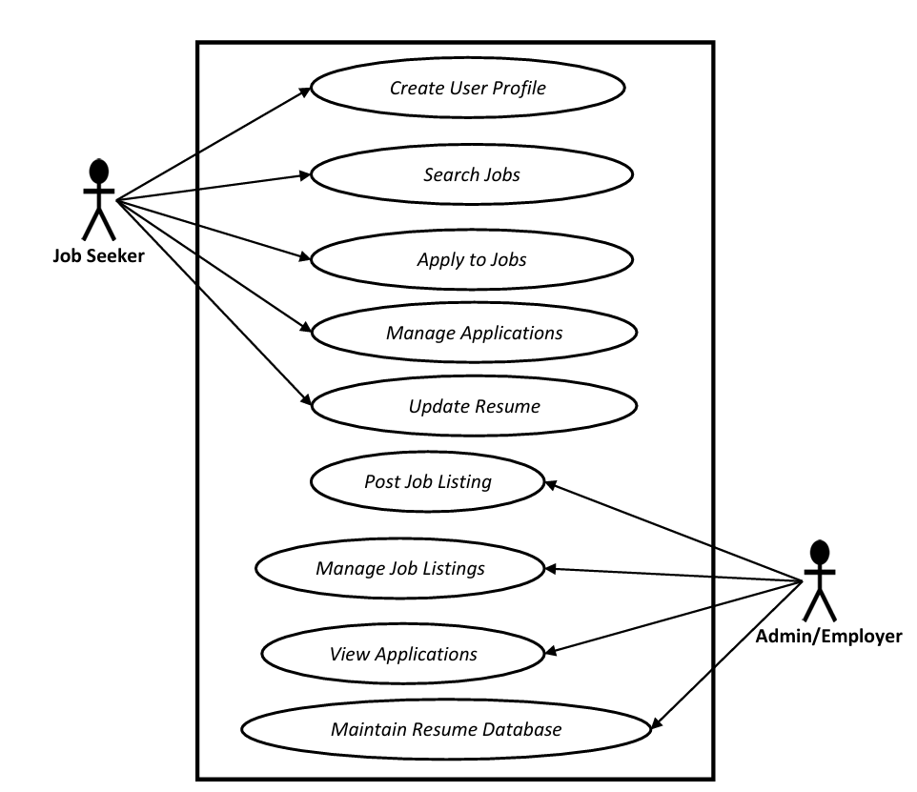
12
Use Case Diagram
Visual Representation of System Interactions
Identifying the different actors interacting with the system (e.g., job seekers, employers). Defining the various use cases or functionalities offered by the system (e.g., post job, apply for job). Defining the scope and boundaries of the system. Visualizing the interactions between actors and the system.
Photo by Google

Slide 15
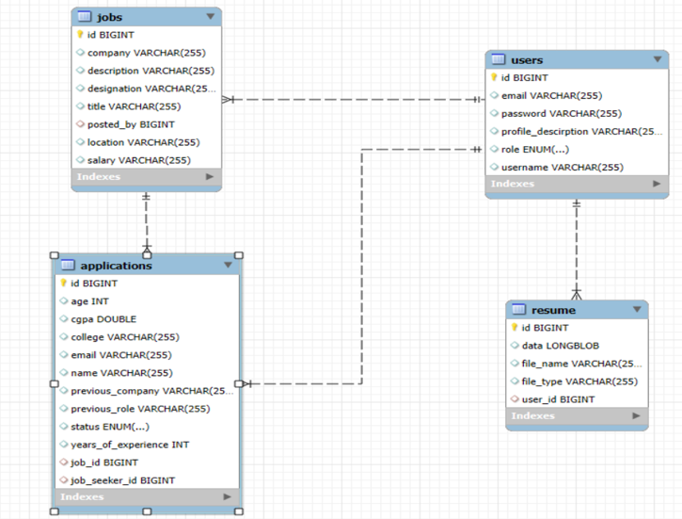
13
ER Diagram
Photo by Google

Slide 16
THANK YOU!
Photo by Google

